Slide 1
How Immigration Policy Shapes Advocacy with Im/migrant Women
Presented by Rupaleem Bhuyan, PhD
University of Toronto, Faculty of Social Work
For Her Own Good Conference
Vancouver, British Columbia
November 1, 2011

Slide 2
Overview
Supporting Immigrant and Refugee Women Who are Being Abused
Changes in Immigration and Immigration Policy
Negotiating Social Rights in Service Delivery
Study Objectives and Methods
Themes of Analysis
Points of discussion and future work

Slide 3
Acknowledgements
Funding Support:
CERIS—Ontario Metropolis Center Funding
Supporting Organizations:
Women Abuse Council of Toronto
Sistering
Women’s Health in Women’s Hands Community Health Centre
Toronto Rape Crisis Centre
Ontario Association for Transitional and Interval Housing
South Asian Legal Clinic of Ontario
Graduate and Community Research Assistants
Tracy Smith-Carrier
Daphne Jeyepal
Helen Waigumo Gateri
Isabel Garcia

Slide 4
Supporting Immigrant & Refugee Women
Identified Barriers (MacLeod & Shin, 1993; Jiwani, 2001; Mosher, 2004):
Language barriers
Economic insecurity; Dependence on abusers
Isolation
Impact of migration and fear of policy and immigration officials
Pressures of multiple family roles
Racism and Cultural Imperialism
Support Strategies (Battered Women’s Support Services, 2010; Smith & Mirza-Beg, 2003):
Advocating for women’s immigration options, depending on their specific immigration status
Greater “cultural competency” in the justice system and in agencies that delivery services
Culturally appropriate education materials on violence against women to be used with ethno-cultural groups
Networks and partnership to address the VAW in immigrant and visible minority communities
Notes:
Proceedings from “No Where to Turn? Forum” (CCSD, 2004; Smith & Mirza-Beg, 2003) – a community based initiative aimed at exploring partner violence against immigrant and visible minority women - offered specific strategies to develop appropriate services for immigrant and visible minority women including:

Slide 5
Canadian Immigration
Three Primary Channels for Immigration
Permanent Resident Sponsorship for Family Reunification (spouses, dependent children, parents, grandparents)
Permanent Resident Application for Skilled Workers for Nation-Building– To fuel economy and maintain labour supply
International and Domestic Humanitarian Obligations
Convention Refugees: In-Country and from Abroad
Permanent Residence Application on Humanitarian and Compassionate Grounds
Growth in Temporary Residents
Students, Business Travelers, Foreign Workers, Refugee Claimants, and visitors

Slide 6
2008 Snapshot: Permanent vs. Temporary
Permanent Residents Temporary Residents
Category | Number | %
Family Class | 65,567 | 26
Economic Immigrant | 149,072 | 60
Refugees | 21,860 | 9
Other Immigrant | 10,742 | 4
TOTAL | 247,243 | 100
Category | Number | %
Foreign Worker | 363,494 | 41
Foreign Student | 242,861 | 28
Humanitarian | 124,835 | 14
Other | 148,451 | 17
TOTAL | 879,641 | 100
Adapted from CIC (2009)

Slide 7
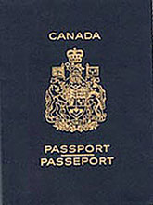
Defining Precarious Status

Shifts in Canadian immigration policy produce new and longer episodes of precarious status
In 2009, nearly 1 million temporary residents accounted for by Citizenship and Immigration Canada =1 in 34 people in Canada (CIC, 2009)
Precarious Status marked by the lack of any of the following (Goldring et.al., 2010):
Work authorization
The right to remain permanently in the country
Social and political rights available to permanent residents
(i.e. housing, healthcare, social assistance, child care subsidy, mobility in and out of Canada, family reunification)
Not dependent on a third party for one’s right to be in Canada
(i.e. such as a sponsored spouse or employee)

Slide 8
Canadian Immigration Policy
A concurrent power between federal and provincial govts
Government of Canada Departments
Citizenship and Immigration Canada (CIC)– Manages temporary and permanent immigration; integration of immigrants
Refugee Board of Canada– Administrative tribunal responsible for humanitarian claims
Canada Boarder Services Agency (CBSA)—Oversees border services; responsible for detaining or deporting unauthorized migrants
Devolutionary trends through numerous bilateral agreements
Immigration settlement and integration devolved to provinces
Federal paramount over immigration control

Slide 9
Negotiating Social Rights on the Frontlines of Service Delivery
Study Objectives
Theoretical Framework
Research Methods and Data Collection
Themes of Analysis
Shelter Sanctuary Status Campaign
A case study for anti-violence immigrant organizing
Notes:
Examples of community planning: how to redevelop the water front in Toronto along Lake Shore Drive, so it is more pedestrian friendly, while maintaining/restoring the ecosystems of the local rivers and watersheds, and not dislocating low-income residents.
Community development is another broad term that takes on different meaning when applied locally when businesses work closely with government. This term is also circulated broadly in international contexts, with regard to international investments into resource poor nations and communities for economic and human development.
Social workers have used this term to signal strategies that engage community members towards local control of the destiny of their communities. In this case, generating revitalization efforts, or economic development, through use of local resources to leverage change.

Slide 10
Study Objectives
Funded by CERIS—The Ontario Metropolis Centre
To explore how immigration status and citizenship influence everyday encounters with social services providers in violence against women programs
To examine how service providers manage the sensitive identity information for service users
How documentation requirements within organizations – usually as part of their accountability to funders – potentially impact an organization’s ability to provide comprehensive services to those in need

Slide 11
Theoretical Framework
Governmentality
Power as diffused and deployed through social actors
Power as productive
Technologies of control, self-regulation, regulating others
Street-level bureaucrats as policy deliverers
Front-line service work as a type of policy delivery
Front-line workers hold discretionary power over who will benefit from social rights
Intersectionality
Examining intersecting forms of oppression
Examining the structural violence of immigration policy

Slide 12
Methods for Interpretive Policy Analysis
Interpretive Policy Analysis Methodology
Framed by theories of language and meaning-making in policy development and implementation
Focus on people who exchange, respond to, and reconstruct understandings of policy ideas
Data Collection from 2009-2010
Document analysis of federal, provincial, local & organizational policies
Interviews with front-line staff (5), management staff (7), and funders (3) of violence against women programs in Toronto
Observation at anti-violence and immigrant rights coalition meetings

Slide 13
Context--Toronto
Population of 2.48 million; 5.5 million in the Greater Toronto Area
Residents from 200 different ethno-cultural backgrounds
Half of Toronto’s population were born outside of Canada
Half of all immigrants have resided in Canada for less than 15 years
Disproportionate poverty rates:
45% for recent immigrants
33% for racialized populations
32% for children below the age of six

Slide 14
Themes of Analysis

Slide 15
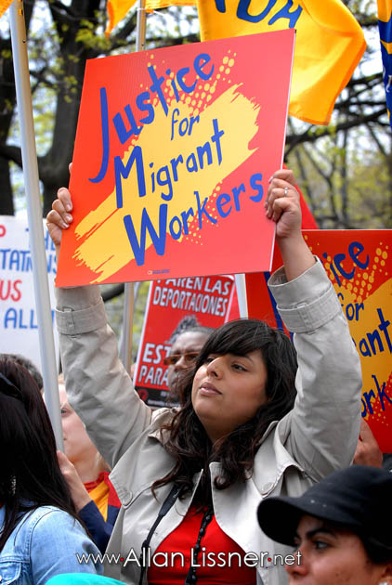
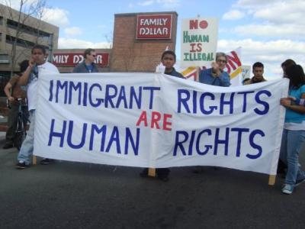
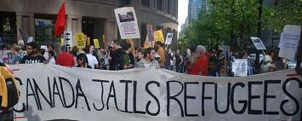
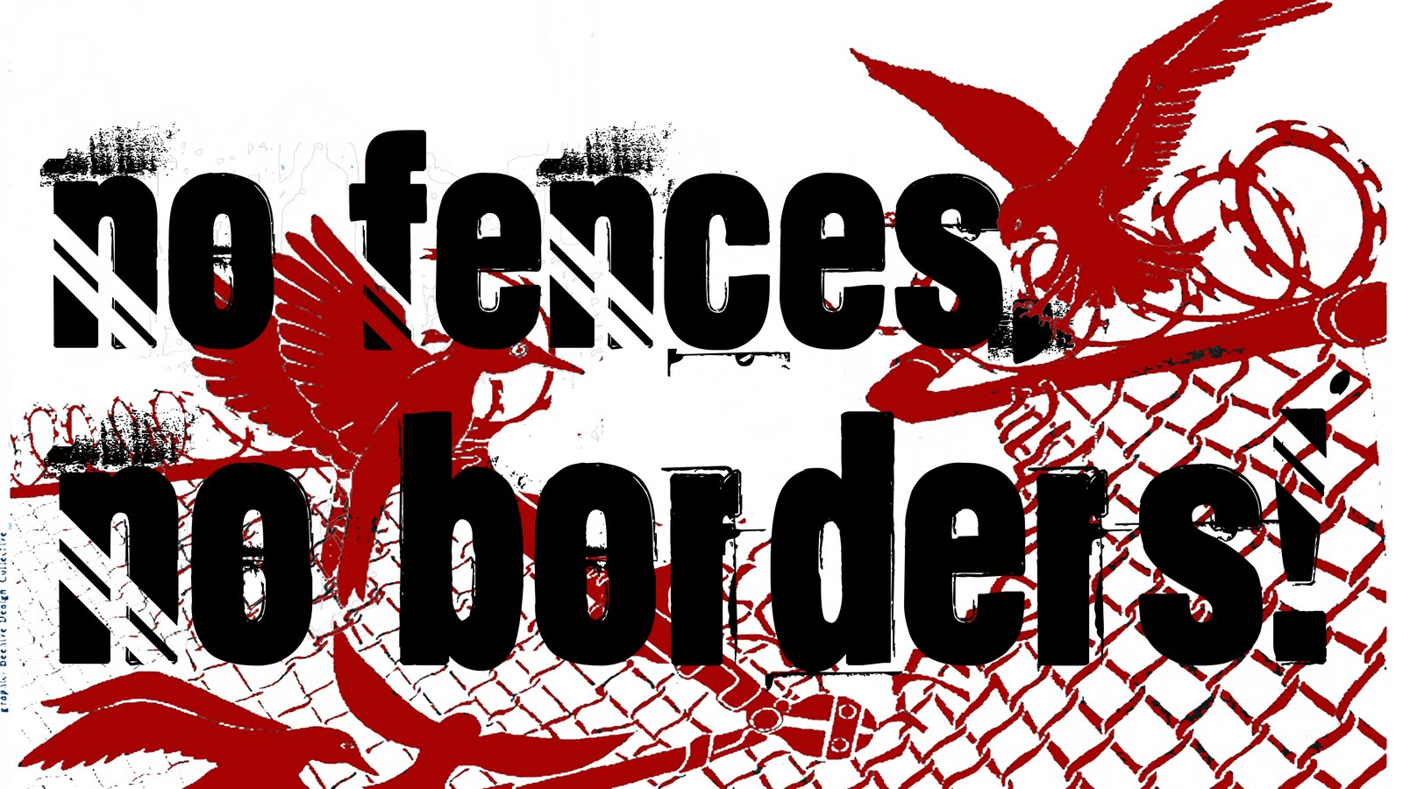
Immigrant Rights
Notes:
This is a common image of community organizing for Immigrant Rights.
How many of you see yourself as an activist/advocate for immigrant rights?
What does this have to do with community practice?

Slide 16
Precarious Status and Human Rights
“Priorities change as soon as people’s status changes as well. When you do not have status any small thing is a big thing, is a big deal. If I get just a little appointment at the community health centre. It’s a big achievement, when you do not have status. When you are a refugee claimant, you have access to medical attention, but you want to go to university. So that’s your dilemma. When you’re a [permanent] resident, you can now access medical attention, but you want to leave the country more frequently. You see, people’s priorities change when their status changes… Citizens have such high expectations in terms of what they want to achieve. So different from the person without status. It is heart breaking… once you are in the ground level, anything would be a benefit. But it shouldn’t be that way. Because medical attention for a pregnant woman, it shouldn’t be a privilege, it should be a right.” (Shelter-based Service Provider)
Notes:
The last phrase of this excerpt signals how service providers use broader notions of human rights to assess the conditions faced by the women that they work with. While several participants in this study talk about rights that the women they work with should have, some even referencing the Canadian Charter of Rights and Responsibilities, different legal categories determined the material resources available for migrants seeking health and social services.

Slide 17
Precarious Status in VAW Shelters
“We often say they’re a combination of mostly newcomers and old-comers. We get a fair number, a disproportionate number of Aboriginal women to the population and lots of newcomer women… Typically [we’re] working with the women with the least safety nets under them.” (Shelter Manager)

Slide 18
Types of Status in VAW Shelters
Non-status due to expiration of visitor visa
In the midst of sponsorship breakdown
Waiting for refugee or humanitarian claim determination
Failed refugee claimant
Failed refugee claimant with deportation order
Families with mixed-status

Slide 19
Broader Socio-Economic Factors—Welfare Cuts and Economic Insecurity
“About five years ago we noticed that there was a trend in shelters, that we were serving about half of the women and kids that we had served probably 10 years ago… We found that all of a sudden we had people staying four to six months, and sometimes up to a year. A lot of different reasons for that. Some of it is immigration. Some of it is lack of affordable housing. Some of it is the lack of ability to access any kind of private market on your social systems check. So all of those things combined meant that women were kind of stuck. So we couldn’t get people out. So people couldn’t come in.” (Shelter Manager)
Notes:
While the current Government in Ontario, led by Premier Dalton McGuinty, instituted a Domestic Violence Action Plan for Ontario in 2004 to signal their support for women’s issues, violence against women programs in Ontario remain underfunded (Ministry of Citizenship and Immigration, 2004). Furthermore, current funding focuses on service delivery while prohibiting advocacy and community mobilization, strategies that were vital to the social movement that fought to raise public consciousness of violence against women as a social justice and women’s rights issue.

Slide 20
How Status Shapes Service Delivery
“Immigration status is not something that we are looking at for a woman to be allowed to enter, to live in the house. However, we ask the question because that makes an impact on all the services.” (Shelter-Based Service Provider)
“We try to really leave it up to the client to decide what she wants to do. We want to present all the options and we’re not trying to be unrealistic about what the possibilities are and what they are not. But you know, she may not know all of the possibilities, so we provide as much information as we can, but it’s up to her to decide.” (Shelter-Based Service Provider).
Notes:
Although VAW shelters are open to all women and their children experiencing violence, once women enter the shelter, status shapes what resources within the organization are available to support a woman, which social and health services a woman may be able to access in the community, and even impacts what aspirations a woman may express, given her circumstances.

Slide 21
Negotiating Rights with Surveillance
“If she wants to receive PNA, personal needs allowance, that is money coming from the City. Any woman living in a shelter is entitled to receive that money, however, women with non-status, especially women with the deportation orders or warrant for arrest need to be aware that if they were to receive that money, it could happen that their name could be pulled out, because the connection between Ontario Works and Immigration. It is clear that there is a connection. It is clear that they share information. It is absolutely clear that it is happening” (Shelter-Based Service Provider)

Slide 22
Maintaining a “Good” Image
We’ve been using the term precarious status for women who are still involved with the immigration system in some way and haven’t managed to attain their landed status or citizenship… We found that most women are in fact somewhere in the legal process. You know they are either in the refugee process or they have applied and been turned down and they’re about to make an appeal. Or they’ve applied for an H&C or you know they’re somewhere in that process… But almost all of the women that we serve are somewhere in that process which I think is a really important clarification which we wanted to bring to our board (Executive Manager, VAW Program).

Slide 23
Common Barriers to Providing Services to Women with Precarious Status
The lack of organizational resources available to support women with precarious status
Difficulty referring women to other services due to ineligibility or lack of identification documents
The lack of organizational support/response for addressing immigration related barriers
The lack of information or misinformation about immigration policy
The need to comply with funding requirements to maximize output of service delivery
Concern about doing something that is ‘illegal’
A fear of immigration law enforcement
Notes:
In the face of these barriers, VAW service providers are committed to advocating for migrant women and providing a range of services to support women with precarious status.
We focus on both proactive and defensive strategies that service providers employ to support the women they serve:
To maximize access to social and health services
To mitigate the negative effects of immigration policy.

Slide 24
Proactive Advocacy Strategies
Providing women and their children with emergency shelter, irrespective of immigration status
Developing ‘access without fear’ organizational practices
Assessing and referring clients to immigration attorneys
Assisting women to relocate, if they fear deportation
Advocating to change organizational policies or funders’ guidelines to be more responsive to the needs of women with precarious status
Joining and supporting grassroots campaigns to address the systemic issues of immigration, towards greater protection for migrant women and regularization for women with precarious status.
Notes:
“VAW shelter service providers report using both proactive and defensive advocacy strategies when working with women with precarious status. We define “proactive advocacy strategies” as situations when service providers seek to challenge or circumvent immigration policies that impede women’s ability to seek safety and support for themselves and their children”.
Despite these barriers, VAW shelter service providers report using both proactive and defensive advocacy strategies when working with women with precarious status. We define “proactive advocacy strategies” as situations when service providers seek to challenge or circumvent immigration policies that impede women’s ability to seek safety and support for themselves and their children. Proactive advocacy strategies include both individual and systems advocacy including: providing women and their children with shelter, irrespective of immigration status; developing clear ‘access without fear’ organizational practice guidelines; or assisting women to relocate, if they fear detection by immigration enforcement.

Slide 25
Defensive Advocacy Strategies
Brokering with immigration officials to delay deportation so a woman residing in a VAW shelter can get her documents and life in order before her deportation date
Not collecting information regarding clients plans when they decide to leave the shelter to go live ‘underground’
Limiting the length of shelter stays for women who are non-status, or who are not eligible for social housing or housing subsidies
Withdrawing or withholding public support for political or grassroots campaigns that criticize the state (e.g. Canadian Border Services Agency)
Notes:
We also identified defensive strategies, which we conceptualize as activities that seek to minimize the effects of immigration enforcement activities for both migrant women and service providers who feared further scrutiny from the government and the potential loss of funding due to their advocacy for non-status women. Defensive advocacy strategies included:

Slide 26
Shelter Sanctuary Status Campaign— A Case Study in Anti-Violence Immigrant Organizing
Launched in November 2008 by No One Is Illegal Toronto, after a series of cases where women’s refugee claims on gender violence were denied
Called for a collective stance in violence against women sector to regularize nonstatus migrants and ensure all women could access service without fear of deportation
Activities included:
Educational workshops for service providers on immigration and immigrant rights
Working with organizations to develop ‘Access without fear” policies
Organizing shelter residents and service providers to take part in direct actions and demonstrations against IRB and CBSA
Targeted CBSA enforcement in VAW shelters

Slide 27
Responses to SSS Campaign
At launch, over 150 people marched with to protest Immigration Refugee Board offices in Toronto
Within first year, over 200 organizations signed on in support of the SSS campaign goals
Following March 8, 2009 press conference, many VAW shelters pulled back public support after a woman gave testimony to her fear of CBSA who had come to a shelter to detain her
Targeting local CBSA Official in the Greater Toronto Area led to a regional directive barring CBSA officers from entering women’s spaces
Negotiation with local CBSA led to National Policy issued Feb. 14, 2011
Included new protections for violence against women shelters
Asserted Federal authority to enforce deportation orders, in the name of National Security

Slide 28
VAW Response to CBSA Directive
“Services that work with women and children who experience violence are dedicated to keeping women safe from violence and maintaining their confidentiality. That is our mandate and it is the mandate of all services that work to end violence against women. We’ll continue to follow that mandate. If CBSA isn’t prepared to comply with the Charter of Rights and Freedoms in Canada, we still are. Services will need to make decisions about how they can do that to protect women and their children from violence”
(Eileen Morrow of the Ontario Association of Interval and Transitional Houses, February 14, 2011).

Slide 29
Discussion Points
Who gets protected by “Don’t Ask Don’t Tell” policies?
Movement towards “Access without Fear”
What fuels fear of immigration politics within VAW sector?
Depoliticization of VAW sector in general;
Racism in the politics of agenda setting; What forms of violence are ‘seen’ as justifying shelter use?
Fear of losing funding; Funding as a form of surveillance
Paradox of state power; Abdication of power to determine whom we should serve

Slide 30
Take Action for Immigrant Rights
Contact your MP & Jason Kenney
Proposed two year conditional permanent resident status for sponsored spouses See Canadian Council of Refugees Statement on Proposal. For more info: http://ccrweb.ca/en/conditional-permanent-residence
Bill C-4 proposed changes to refugee determination, creating two tiers of refugees in Canada (in the name of smuggling enforcement). See No One is Illegal for more info: http://noii-van.resist.ca/?p=4303
http://toronto.nooneisillegal.org/node/616

Slide 31
References
Battered Women’s Support Services. (2010). Toolkit for lawyers. Best practices in working with battered immigrant women. A BWSS Toolkit.
Goldring, Luin, Carolina Bernstein, and Judith Bernhard. 2010. “Institutionalizing Precarious Migratory Status in Canada,” Citizenship Studies 13 (3): 239-265.
MacLeod, L., and M. Shin. (1990). Isolated, afraid and forgotten: The service delivery needs and realities of immigrant and refugee women who are battered. Health Canada: National Clearinghouse on Family Violence Health and Welfare Canada.
Mosher, J, (2009). The complicity of the state in the intimate abuse of immigrant women. In Racialized Migrant Women in Canada. Essays on Health, Violence and Equity. Vijay Agnew (ed.) University of Toronto Press. 41-69.
Smith, Ekuwa. 2004. Nowhere to Turn? Responding to Partner Violence Against Immigrant and Visible Minority Women. Ottawa, ON: Canadian Council of Social Development.

