Slide 1
Criminalizing “Marriage Fraud” at Multiple Borders Tracing the Gendered and Racialized effects of Crimmigration in Canada Rupaleem Bhuyan, Anna Korteweg, & Karin Baqi Migrant Mothers Project University of Toronto
Society for Social Work Research
January 15, 2017
New Orleans, LA

Slide 2
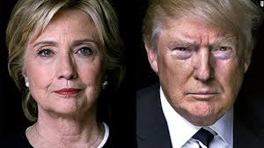
"Canadians are generous and welcoming, but they have no tolerance for fraudsters who lie and cheat to jump the queue," said Minister Kenney. "This measure will help strengthen the integrity of our immigration system and prevent the victimization of innocent Canadians.”
Minister Jason Kenney, Citizenship & Immigration Canada (2012)
Notes:
Emphasis on “marriage fraud” as a threat to the nation along with restrictions on marriage migrants maintains the racelessness of Canada’s policy discourse since overt racial exclusions were removed in the 1960s. Yet, when considering that 83% of all family contemporary migration to Canada originates in Asia, Africa and South America (what are colloquially referred to as “non-traditional source countries”), the regulation of sponsored spouses represents a de facto policy for controlling the migration of racialized immigrants.
Maryam Monsef. First Afghan appointed to the Cabinet. May be stripped of her citizenship without a hearing, due to misrepresentation of birthplace on her birth certificate (it says Afghanistan, but she was born in a hospital in Iran).

Slide 3
“How Conditional Settlement Impacts Immigrant Women”
Study Objectives (2015-2018):
Explore immigration policies that impact safety of sponsored spouses & partners & caregivers
Creation of 2-year Conditional Permanent Residence for sponsored spouses/partners, 2012
Understand how immigration enforcement impact immigrants access to support services
Build capacity for community organizing and participatory research with immigrant women
Notes:
This paper is part of a multi-year study of “Conditional Settlement for Immigrant Women in Canada” with a focus on sponsored spouses/partners and temporary foreign workers in the Live-in-Caregiver Program. While previous scholars have illustrated techniques for disciplining unauthorized or nonstatus immigrants (De Genova, 2002; Doty & Provine, 2011; Varsanyi, 2008), this study examines how a growing proportion of immigrants who have a legal status in Canada are also vulnerable to losing their status and thus bear the threat of deportation.

Slide 4
Research Design: Interpretive Policy Analysis
Multi-method discourse analysis
Meanings associated with policy and its impact(s)
Language-in-use; language-as-representation
Sources of Data:
Individual Interviews with Key Stakeholders (23):
Immigration advocates, lawyers, settlement workers
Toronto & Calgary
Parliamentary Debate 2011-2012
Public Policies & Regulations 2012-present
Federal data on entry of sponsored spouses/partners 2013-2015
Forthcoming:
Interviews with sponsored spouses (planned for 2017)

Slide 5
Canadian Context
Canada = white settler state
Immigration and nation building
First Nations, Inuit, Metis and Indigenous peoples struggle for sovereignty and basic needs
Multiculturalism, state policy since 1980s
Seeks equality for all
Maintains White Supremacy
e.g. English & French are official languages
Relatively high public support for immigration
PM Trudeau’s Liberal gov’t since November 2015

Slide 6
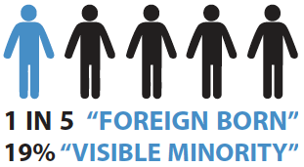
Policy & Demographic Shifts
Steady immigration since the 1980s
Average 250,000 new PR/year (proposed 300,000 for 2018)
Top Source Countries: Philippines, India & China
2008-2014, most active period of policy change
Family Reunification, Economic, Humanitarian & Citizenship
Over 100 policy changes (legislated and regulatory)
⬆ Marked growth in temporary migration (1 in 30 residents)
Temporary foreign workers (high skilled & low-skilled)
International students
New conditions on family sponsorship
Fewer refugee claimants

Slide 7
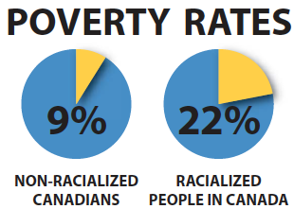
Growing Immigrant Poverty
Most immigrants are highly skilled, yet underemployed or unemployed
35% poverty rate for immigrants, <5 years in Canada

Slide 8
Theoretical Framework
Crimmigration Stumpf (2006)
Expansion of immigration control through the criminal justice system.
Empowers a diversity of state and non-state social actors to take part in policing noncitizens while reinforcing state sovereignty through social control and moral regulation (Chan, 2005).
Notes:
Borders are not only territorial markers
Extends regulation of mobility beyond state borders
Involves an “ever-expanding array of public and private bodies”
eg. police, medical authorities, schools and universities, transport providers, employers, and other private citizens
The regulation of spousal immigrants through conditional PR extends Canada’s multiple borders strategy of illegalizing immigrants (Bauder, 2013) to new spatial and temporal dimensions. While federal authority over immigration controls remains paramount in Canada, immigration enforcement involves a range of state and non-state actors who take part in regulating immigrants (Bhuyan, 2012). The devolution of immigration enforcement has transpired through the production of a “ubiquitous, structurally embedded border” (Weber, 2015). Local law enforcement (Decker, Lewis, Provine, & Varsanyi, 2008), quasi-state service providers (e.g. welfare workers) (Bhuyan, 2012; Mosher, 2009), and commercial airlines (Adey, 2003; Wilson & Weber, 2008), for example, take part in the surveillance of immigrants through identifying and sorting citizens from non-citizens, restricting mobility and access to public benefits, and sharing information with immigration officials. Weber (2013) argues that, “active and passive dimensions of the embedded border rely, respectively, on strategies of surveillance and attrition—or, alternatively, through surveillance and the avoidance of surveillance” (p. 114). In this context of diffused surveillance, individuals exercise self-discipline as a mean’s to avoid more overt forms of control from the state (e.g. where individuals present themselves for ‘voluntarily’ departure).

Slide 9
Theoretical Framework
Structurally Embedded Borders (Weber, 2015)
Borders are not only territorial markers that draw physical lines between states.
They incorporate “an ever-expanding array of public and private bodies including police, medical authorities, schools and universities, welfare and regulatory agencies, transport providers, local government, employers, landlords and other private citizens” (Weber, 2015)
Local law enforcement, quasi-state workers (i.e. welfare), and commercial airlines participate in immigrant surveillance.

Slide 10
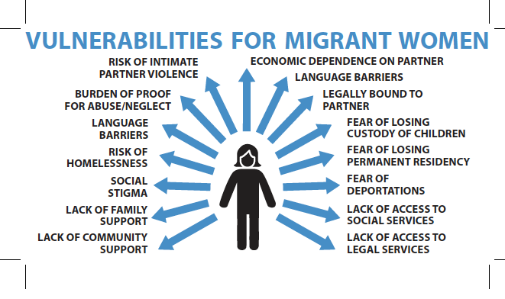

Slide 11
Crimmigration – Canadian Context
87,317 migrants detained 2006-2014 (noii, 2014)
Many without a specific criminal charge
No limit on length of detention
Primary targets of detention & deportation
“Failed refugees”
Criminal Removals
Racialized men (i.e. African, Arab)
“Criminalizing” administrative violations
“Bogus refugees”
“Fake visa students”
“Marriage fraudsters”
Notes:
surveillence and scrutiny of “authentic” relationships takes place pre- and post-migration. Immigration controls include direct bans on certain types of marriages (i.e. polygamous, proxy marriages), but also indirect control through bureaucratic processes and self-control. In Table 1, we present the primary sites where a genuine relationship is scrutinized and regulated: a) preemptively during the pre-migration (or pre-immigration) application process, b) post-migration during the two-year conditional period, and c) post-migration after the two-year conditional period has expired.

Slide 12
Case Study: Criminalizing Marriage Fraud at multiple borders

Slide 13
“The Jig is Up on Marriage Fraud”
Notes:
In 2013, Minster Jason Kenney held a press conference with Sam Benet, co-founder of Canadians Against Immigration Fraud (CAIF) and Palwinder Singh Gill, founder of the Canadian Marriage Fraud Victims Society.
Brampton resident Saranjeet Benet, and his father Sampuran (Sam) Benet, had founded CAIF in 2009 to launch a class action lawsuit at the Federal Court of Canada on behalf “of Canadian sponsors who married foreigners in good faith but were jilted and end up with emotional scars and financial losses.”
Sam Benet, who spearheaded the lawsuit and subsequent lobby efforts with CAIF alleged that his daughter-in-law (to whom he had arranged his son’s marriage) committed fraud and had deceptively entered marriage in order to gain immigration status to Canada. He alleged that she had no interest in consummating the marriage and left the family home shortly after arriving Canada.
Source: http://www.thestar.com/news/gta/2009/03/31/ottawa_sued_over_alleged_marriage_frauds.html.

Slide 14
Fraud Prevention Month
“I have heard stories from victims across the country that have been left emotionally and financially devastated because of immigration fraud,” said Minister Kenney. “The best way to protect oneself is to become informed. I encourage Canadians, and especially newcomers, to visit the Citizenship and Immigration Canada (CIC) website during Fraud Prevention Month to learn about their rights and responsibilities as they relate to citizenship and immigration so they can protect themselves.” Prime Minister Stephen Harper March 2013

Slide 15
Conditional Permanent Residence
Introduced in October 2012
Applies to sponsored spouses/partners who:
Do not have children in common
Are in a relationship for two years or less
Conditions
Must cohabitate in a “conjugal” relationship for two years
May lose status if the relationship ends or if you do not meet the condition
Exceptions
Death of sponsor
“Abuse and Neglect”
Notes:
Similar to policy development in the United States, Australia and the United Kingdom, conditional permanent residence for sponsored spouses was promoted as a means to crack down on “marriage fraud” despite the lack of empirical evidence that this was a significant problem.

Slide 16
“Exception for Abuse & Neglect”
Vulnerability for Domestic Violence
Forced marriage included in 2015
Uneven implementation of the “exception”
3 out of 4 were successful between 2012-2014
Low reporting to CIC
Fear of losing their status more than abuse
Fear for children who all have conditional PR
Cases of ‘neglect’
CIC officials talk to spouse, neighbors and family when investigating abuse
Uncertainty moving from conditional PR to ‘regular’ PR
Notes:
When the Conditional PR was first introduced, more than 80 organizations that work with women and immigrants across Canada signed a statement opposing the Conditional PR, as it is potentially dangerous to immigrants in abusive relationships. The previous government acknowledged that spousal sponsorship may put people who are vulnerable to abuse in more danger, thus they created an “Exception for Victims of Abuse and Neglect”. As the Canadian Council of Refugees has reported, the exception process that is currently set up has many flaws. From our own research with service providers in Alberta and Ontario, we’ve found that many victims of abuse and neglect are fearful that applying for the “Exception” may jeopardize their immigration status. Exacerbating this fear, are CIC staff who lack the necessary training required to respond to people in times of crisis. As such, investigations into reports of abuse may put victims at further risk.

Slide 17
Policing “Marriage Fraud” at Multiple Borders
Pre-Migration Controls
Visa restrictions
Application processing times (up to 48 months for overseas; average of 24 months inside Canada)
Polygamy ban expanded
Terrorism added to ‘criminal inadmissibility’
Post-Migration Controls
Barred on sponsored spouse for sponsoring a new spouse/partner extended from 2 to 5 years
Harsher penalties for “misrepresentation” charge
Introduction of 2-year Conditional PR in 2012

Slide 18
Statistical Profile for Sponsored Spouses From 2013-2014
103,887 newly sponsored spouses, common law partners and conjugal partners
28% with conditional PR
1,973 dependent children with CPR
Top 5 countries, with most CPRs include:
India, China, Philippines, USA, Morocco
Top 5 countries with highest percentage of CPR
Turkey, Tunisia, Azerbaijan, Algeria, Nepal, Morocco, Cuba
Average of 51%-56% received CPR
Notes:
Tried to get updated data since May. It’s currently “under review”

Slide 19
Gender Breakdown of Sponsors and CPRs
Sponsored Spouse/Partner with CPR
Sponsor
Female 64%
Male 36%
Female 36 %
Male 64%
Notes:
Placing a condition on newly sponsored spouses and partners reinforces gender hierarchies. 64% of immigrants with conditional status are female, as opposed to 32% who are male.

Slide 20
Countries with Highest Number of PR with Condition (2013-2014)
Country of Citizenship | Total PR Applications | Total PR with Condition | % with PR Condition
India | 9701 | 4303 | 44%
China, People's Republic of | 9834 | 2632 | 27%
Philippines | 7214 | 2236 | 31%
United States of America | 9084 | 1956 | 22%
Morocco | 2133 | 1087 | 51%
Algeria | 1672 | 902 | 54%
British Citizen | 3085 | 840 | 27%
Iran | 1961 | 714 | 36%
Sri Lanka | 1764 | 709 | 40%
Notes:
While on average, 28% of sponsored spouses and 22% of partners are given conditional PR, the percentage of spouses getting this condition is twice as high for people coming from countries in the Middle East and South Asia (e.g. Morocco, Pakistan, Afghanistan). Up to 54% of all spouses from this region receive a conditional status. Considering the disproportionate number of racialized immigrant spouses who received a “conditional status” this policy functions as a form of racial profiling in immigration law. We argue that couples that do not co-habitat before immigrating or who do not have the capacity to document the genuineness of their relationship over time (e.g. same sex couples who live in regions where it is unsafe for them to be open about their relationship), will be more likely to be subject to conditions on their permanent residence.

Slide 21
Countries with Highest % who Get PR with Condition (2013-2014)
Country of Citizenship | Total PR Applications | Total PR With Condition | % with PR Condition
Turkey | 461 | 258 | 56%
Tunisia | 976 | 541 | 55%
Azerbaijan | 29 | 16 | 55%
Algeria | 1672 | 902 | 54%
Nepal | 180 | 94 | 52%
Morocco | 2133 | 1087 | 51%
Cuba | 1220 | 617 | 51%
Albania | 261 | 116 | 44%
Antigua and Barbuda | 18 | 8 | 44%
Notes:
Processing times, as of Oct 2016
Turkey – 12 months
Tunisia – 8 months
Azerbaizan – 15 months
Algeria – 8 months
Nepal - 12 months
Morroco – 9 months
Cuba
Albania
Antiqua -Barbado

Slide 22
Summary of Key Concerns
6 of 10 countries with highest proportion getting conditional PR are Muslim majority countries
9 of 10 countries with highest CPR in the Global South
9 of 10 countries require a visa to visit Canada
Application processing times expand temporal border
15 months application processing + 2 year conditional PR

Slide 23
Discussion
Raceless construction of ’marriage migrant’ masks racialized effects
Compound effect of pre- and post- migration controls
Reinforces policing of racialized/Muslim immigrants as suspicious of criminal intent
Enables racial and gender discrimination
Normalizes domestic violence
Positions state as protector
Extends bureaucratic control of temporal border

Slide 24
Policy Recommendations
1) Repeal conditional PR and remove condition
Liberals announce plans for repeal in Oct 2016
2) Extend support for immigrant victims of abuse or neglect to secure a pathway to permanent residence
3) Reduce processing times for in-land and overseas sponsored spouses & partners
4) Extend work authorization to in-land sponsored spouses/partners who are waiting for their application to be processed.
Notes:
Need to expand these.
Include slide on analytic points.

Slide 25
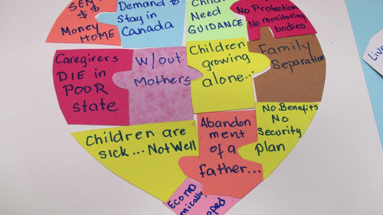
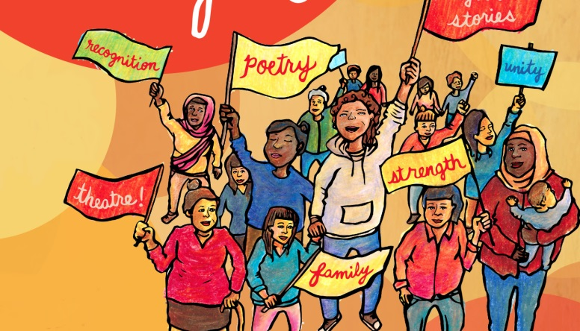
Migrant mothers project
Til Immigrations Tears Us Apart: Stories of Strength through Struggle
Unprotected, Unrecognized:
Canadian Immigration Policy and Violence Against Women, 2008-2013
Rupaleem Bhuyan, PhD
Associate Professor, Faculty of Social Work
University of Toronto
r.bhuyan@utoronto.ca
Website: www.migrantmothersproject.com
Find us on Facebook “MigrantMothersProject”

