Slide 1
Migrant Women & Precarious Immigration Status Rupaleem Bhuyan, PhD Principal Investigator, Migrant Mothers Project Associate Professor, Social Work, University of Toronto
Immigration, Refugees and Citizenship Canada
Gender Based Analysis + Awareness Week
Ottawa, Canada
June 2, 2017

Slide 2
Presentation Agenda
Migrant Mothers Project
Canadian Context
Theoretical Framework
Study Foci & Key Concerns

Slide 3
Migrant Mothers Project (MMP) Overview
2011 - present
Funded by SSHRC, CERIS, University of Toronto
Active network of service providers, legal advocates grassroots immigrant leaders and academics
Community Partners:
Ethno Cultural Council of Calgary
South Asian Legal Clinic of Ontario
Thorncliffe Neighborhood Office
WomanAct
Ontario Council of Agencies Serving Immigrants
METRAC

Slide 4
MMP - Research, Engagement & Advocacy
Research Goals
Understand how immigration policies produce inequalities that contribute to violence against women
Explore how immigrant women negotiate rights and belonging when seeking safety and support
Community Engagement & Advocacy Goals
Connect research to grassroots advocacy
Recommend service delivery & policy changes
Build capacity among people most impacted by the research topic

Slide 5
MMP - Research Studies
Study Foci:
Refugee Claimants
Sponsored Spouses & Partners
International Caregivers
Research Methods:
Analysis of public policy, regulations, and announcements
Demographic data from CIC/IRCC & IRB
Interviews with stakeholders & immigrants
Key Concerns
Vulnerability to family or partner violence
Barriers to accessing safety and support services
Barriers to full citizenship

Slide 6
Intersectionality : Why Gender is Not Enough

Slide 7
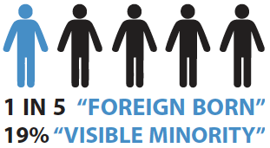
Canadian Context
Steady immigration since the 1980s
Average 250,000 new permanent residents/yr.
Top source countries: Philippines, India & China
Majority of foreign born live in Ontario, British Columbia, Quebec, and Alberta
53% of Canada’s foreign born population live in Ontario (National Housing Survey, 2011)

Slide 8
Policy Trends
2008-2014, most active period of policy change
Family Reunification, Economic, Humanitarian & Citizenship
⬆ Marked growth in temporary migration
Temporary foreign workers (high skilled & low-skilled)
International students
New conditions on family sponsorship
Fewer refugee claimants
Shift to more precarious immigration
Temporary migrants have limited rights
Restrictions on access to permanent residence

Slide 9
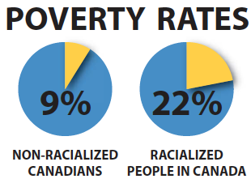
Growing Immigrant Poverty
Most immigrants are highly skilled, yet underemployed or unemployed
35% poverty rate for immigrants, <5 years in Canada
10% poverty rate for the general population

Slide 10
2015: Permanent vs. Temporary
Permanent Residents Temporary Residents
Category | Number | %
Family Class | 65,395 | 24
Economic Immigrant | 170,390 | 63
Refugees | 32,100 | 12
Other Immigrant | 3,843 | 1
TOTAL | 271,728 | 100
Category | Number | %
Foreign Worker | 331,530 | 36
Foreign Student | 459,644 | 50
Humanitarian | 32781 | 4
Other Work Permit | 98144 | 11
TOTAL | 922,099 | 100
Adapted from IRCC (2015)

Slide 11
Immigrant Women
3,544,400 immigrant women and girls in Canada (2011 National Household Survey)
21% of Canada’s population
51% admitted through Economic Class
34% as spouse or dependent
34% through Family Class
9% as Refugees
Trends (Hudon, 2013)
The majority enter as spouses or dependents
Growing proportion of principal applicant, Economic Class
Most female immigrants are ‘visible minorities’ 60.6% of immigrant females vs. 19.3% of total female population

Slide 12
Theoretical Framework
Illegalized vs. “Illegal” Immigrant
Precarious Immigration Status
Structurally Embedded Borders
Intersectionality

Slide 13
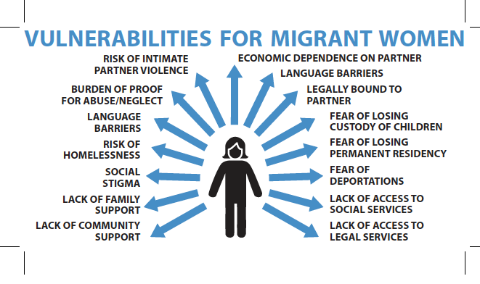

Slide 14
Case Study: Mexican Refugee Claims Related to Domestic Violence
2007-2012

Slide 15
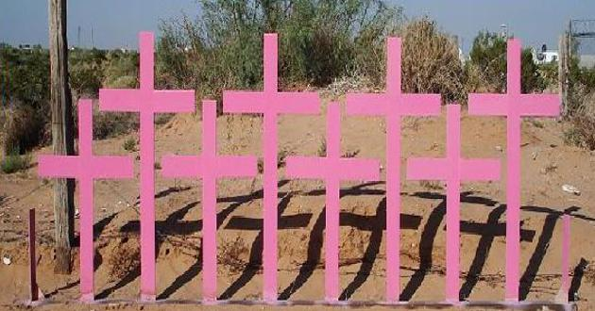
Violence against Women in Mexico
Rates of violence in Mexico:
43.2% of women 15 years of older have been victims of intimate partner violence (emotional, financial, physical or sexual) (ONU, INEGI, 2009)
36,606 femicides from 1985 - 2010
50,000 deaths from 2006-2012 due to drug war (Taylor, 2012)
Mexican Laws
2006 General Law for the Equality between Men and Women
2007 General Law on Women’s Access to a Life Free of Violence, revisions in 2009 and 2014
30 out of 32 states have criminalized violence against women

Slide 16
Mexican Asylum/Refugee Claims Filed During the Year, 2000-2014 (UNHCR, 2015)
 | CANADA | USA
TOTAL | 46,355 | 125,927
% | 27% | 72.8%
Recognized Mexican Refugee Claims, 2000-2014 (UNHCR, 2015)
 | CANADA | USA | OTHER
TOTAL | 7,777 | 3,487 | 46
% | 70% | 29.6% | 0.4%

Slide 17
Mexican Refugee Claimants, Principal Applicants Only, 2007-2012 (IRB, 2012)
819
(17%)
Total number of Claims: 16,028

Slide 18
Domestic Violence as Basis of Initial Claim 2008-2012 (IRB, 2012)
YEAR | MALE | FEMALE | POSITIVE | NEGATIVE | OTHER | DEPENDENTS
TOTAL | 28 | 567 | 152 | 316 | 127 | 377
% | 4.7 | 95.3 | 26 | 53 | 21 | --
10% of female refugee claimants report DV as basis of initial claim, 2008-2012
In 2009, IRB reported that 7% of all claims were gender-related.
Majority denied for inability to prove lack of “state protection”

Slide 19
Gender Based Analysis in Practice
Legal hurdles for recognizing gender persecution (Mawani, 1993)
Persecution against women is often informal, intimate, and indirect
Internal flight alternative presumes women are equally mobile
Evidentiary requirements presume women have access to justice
Refugee receiving vs. refugee producing countries
Uneven response to “barbaric” vs. “universal” violence
Backlash to feminism and equity agenda (Sadoway, 2008)
Cursory attention to “Guidelines” for gender-based violence
IRB accepts domestic violence laws as constituting state protection
Appeal process does not assess how the gender guidelines are used

Slide 20
Case Study: Regulating Transnational Marriage Through Canada’s Multiple Border Strategy 2012-2017

Slide 21
Conditional Permanent Residence (2012-2017)
Introduced in October 2012 as part of Federal Government’s crackdown on “marriage fraud”
Two-year condition for sponsored spouses/partners who:
Are in a relationship for two years or less
Do not have children in common
Conditions
Must cohabitate in a “conjugal” relationship for two years
May lose permanent resident status if the condition is not met, or if relationship ends
Exceptions
Death of sponsor
“Abuse or neglect”
REPEALED in April 2017

Slide 22
International Marriages & Canada’s Multiple Border Strategy
Pre-Immigration
Post-Immigration
Sponsorship application & interview to prove “authentic relationship”
Criminal background check
Polygamy ban
Visa requirement for entering Canada
Border control at ports of entry
Conditional PR (2-yrs)
Sponsorship Ban (5 yrs)
Misrepresentation
Undertaking (3 yrs)
Criminal inadmissibility
Polygamy and inadmissibility

Slide 23
Statistical Profile for Sponsored Spouses (2013 – 2015)
58 218 newly sponsored spouses, common law partners, conjugal partners and children received CPR (Government of Canada, 2016)
42% of all spouses, partners and children in the family reunification program
63% CPR sponsored spouses were female
Top 5 countries, with highest volume with CPR:
India, China, Philippines, USA, Morocco
Top 5 countries, highest proportion with CPR
Turkey, Tunisia, Azerbaijan, Algeria, Nepal, Morocco, Cuba
Average of 51%-56% received CPR

Slide 24
Impacts of Conditional Permanent Residence
Applying for “exception for abuse and neglect” was inconsistent
Many feared consequences of reporting to CIC/IRCC
Women with children who have conditional PR
Service providers report that women are remaining with abusive partners, for fear of losing status
Fear of reporting abuse to police related to fear of deportation
Cases of marriage breakdown
After arriving in Canada, sponsored immigrant learns that spouse/partner has a new relationship
Both spouses/partners amicably separate
Cases were Exception for Abuse & Neglect was denied because violence was not “severe enough”
CIC officers interviewed spouse and family members, increasing risk to women seeking protection

Slide 25
Lessons from CPR Implementation
Facially neutral construction of ‘sponsored spouse’ masks racialized and gendered effects
Compound effect of pre- and post- migration controls
Reinforces policing of racialized/Muslim immigrants as suspicious of criminal intent
Enables racial and gender discrimination
Unclear role for IRCC to provide protection to people abused by their sponsor:
Parents & grandparents Spouse/Partner
Children Temporary Foreign Worker

Slide 26
MMP Policy Recommendations
Repeal conditional PR and remove condition on those who received it since 2012 – ACHIEVED!
Offer waiver for in-land sponsored spouses/partners who are abused by their sponsor; to secure a pathway to permanent residence
Waive 5 year ban and undertaking requirement in cases of abuse and neglect
Reduce processing times for in-land and overseas sponsored spouses & partners
Permanently extend work authorization to in-land sponsored spouses/partners who are waiting for their application to be processed.

Slide 27
MMP Policy Recommendations
Introduce privacy protections for victims of crime who report domestic violence or trafficking to police
Reduce application fees for permanent residence and citizenship
Remove Mexico from the Safe Country list
Require gender based guidelines to be applied substantially to all refugee decisions
Extend open work permits to temporary foreign workers
Promote national immigration strategy/ sanctuary on so that immigrants who face abuse or neglect may access essential services

Slide 28
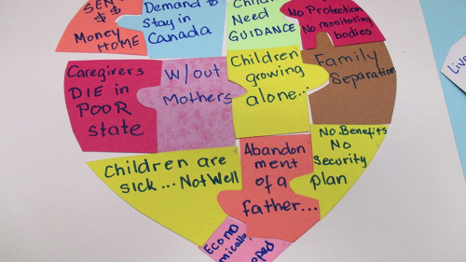
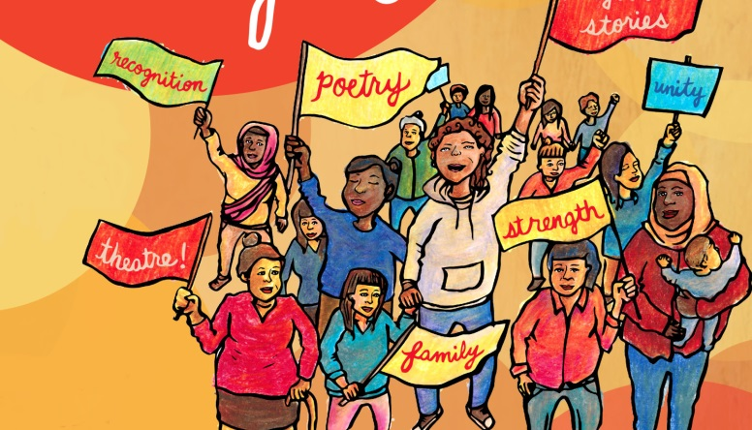
Migrant Mothers Project
Til Immigrations Tears Us Apart: Stories of Strength through Struggle
Unprotected, Unrecognized:
Canadian Immigration Policy and Violence Against Women, 2008-2013
Principal Investigator
Rupaleem Bhuyan, PhD
Associate Professor
Factor-Inwentash Faculty of Social Work
University of Toronto
r.bhuyan@utoronto.ca
Project Website: http://migrantmothersproject.com
Find us on Facebook “MigrantMothersProject”

Slide 29
References
Bhuyan, R., & Smith-Carrier, T. (2012). Constructions of migrant rights in Canada: Is subnational citizenship possible?. Citizenship Studies, 16(2), 203-221.
Bhuyan, R., Osborne, B. J., & Cruz, J. F. J. (2016). “Once You Arrive, Se Te Sala Todo”(Everything is Salted): Latina Migrants' Search for “Dignity and a Right to Life” in Canada. Journal of Immigrant & Refugee Studies, 14(4), 411-431.
Goldring, L. & Landolt, P., eds. 2013. Producing and Negotiating NonCitizenship: Precarious Legal Status in Canada. Toronto: University of Toronto Press.
Government of Canada (2016). Regulations Amending the Immigration and Refugee Protection Regulations. Canada Gazette, Vol. 150. Available at
Hudon, T. (2013). Immigrant Women [webpage]. Statistics Canada, Government of Canada, Ottawa. Available at http://www.statcan.gc.ca/pub/89-503-x/2015001/article/14217-eng.htm#n8
Immigrants, Refugees and Citizenship Canada (2015). Facts and Figures: Immigration Overview (2015). Permanent and temporary residents. Government of Canada, Ottawa. Available at http://www.cic.gc.ca/english/resources/statistics/menu-fact.asp

Slide 30
References (continued)
Mawani, N. (1993). The factual and legal legitimacy of addressing gender issues. Refuge, 13(4).
Mitchel, E. (2013). I am a woman and a human: a Marxist feminist critique of intersectionality theory. The Charnal House. Available at https://thecharnelhouse.org/tag/eve-mitchell/
Nyers, P. 2010. “No One is Illegal between City and Nation”. Studies in Social Justice 4(2): 127-143.
Sadoway, G. (2008). The gender factor in refugee determination and the effect of "gender guidelines". In M. Hajdukowski-Ahmed, I. Khanlou, & H. Moussa (Eds.), Not born a refugee woman (pp. 244-253). New York, Oxford: Berghahn Books.
Statistics Canada (2011). Immigration and ethnocultural diversity in Canada. Government of Canada, Ottawa. Available at http://www12.statcan.gc.ca/nhs-enm/2011/as-sa/99-010-x/99-010-x2011001-eng.cfm

